Slide 1
Validity and Examination Development
Philip D Dickison, PhD, RN
Chief Officer Operations and Examinations
NCSBN

Slide 2
Objectives
By the end of the session, participants will be able to:
  Discuss the essential relationship between examination validity and item development

Slide 4
Content

Slide 5
Practice Analysis
Job analysis
A large-scale survey of entry-level incumbents of activities performed on the job
Results guide content distribution on the licensure examination
Notes:
Note: “Job analysis”

Slide 6
Test Plan
Developed from the most recent practice analysis results
Guides content delivery for every exam
Serves as a study guide for candidates

Slide 7
Item Development
Item writing
Item review
Additional Review Processes:
  Sensitivity
  Differential item functioning (DIF)
  Editorial review
  Regulatory body review

Slide 8
Item Writers
Actively teaching entry-level nursing students
Create test questions (items) based on the current test plan
Have not participated in nursing licensure exam preparation activities in the past two years

Slide 9
Item Reviewers
Actively working with entry-level nurses
Review items for accuracy, currency and entry-level appropriateness
Have not participated in nursing licensure exam preparation activities in the past two years

Slide 10
Unintentional Bias Reviews
Ensure the exclusion of insensitive, unintentionally biased language
Words or phrases which may affect exam measurement are removed

Slide 11
Regulatory Body Review
Conducted biannually
Review criteria
  Entry-level appropriateness
  Nurse practice act congruency
Comments forwarded to examination oversight body

Slide 12
PSYCHOMETRICS

Slide 13
Unintentional Bias Reviews
Sensitivity Review
DIF Review
Readability Analysis

Slide 14
Unintentional Bias Reviews
Criteria
  Stereotypes
  Inflammatory material
  Language
  Assumptions

Slide 15
Differential Item Functioning (DIF)
Difficulty of an item should only be reflective of the nursing content measured
It should not be contingent upon factors irrelevant to the nursing practice
Regardless of the other factors, the difficulty of an item relative to the other items should remain the same

Slide 16
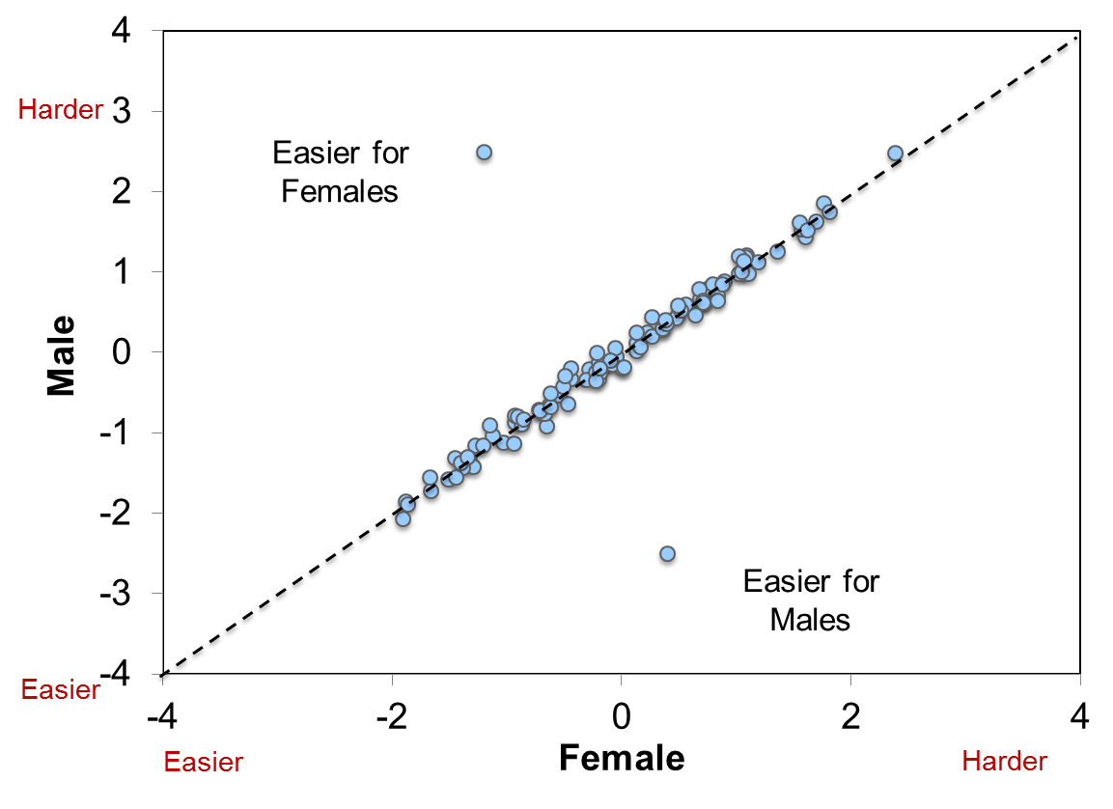
The Concept of DIF

Slide 17
Differential Item Functioning (DIF) (continued)
If an item shows a statistically significant amount of DIF, it is reviewed by a DIF panel to determine if there is an identifiable problem with the content
If the panel determines that there is bias, the item is reviewed by the NEC

Slide 18
Readability
The relative ease or difficulty with which a reader understands text
Readability analysis is performed on all operational item pools
When reading ability is not part of the construct of interest, reading demands should be kept at the lowest level possible

Slide 19
Security

Slide 20
Safeguarding Items During Development
•Mandatory Annual Employee Security Training
•On-site work requirement for content developers
•Highly secure office environment
•Face-to-face panels

Slide 21
Safeguarding Items During Development
•Secure content management system
•Web-surveillance
•Large item bank to support frequent exam rotation
•Ability to immediately remove content

Slide 22
NCLEX Operations Security
Test Center Security Practices
Candidate Statement (Candidate Rules)
Result Holds
Security Contacts

Slide 23
Video Cameras and Audio Recording
Video cameras and a microphone are in the testing room
A video monitor is at the proctor station
Digital tape is available for review in cases of unusual incidents

Slide 24
Result Holds
Evidence of invalid results may include:
  Observed irregular behavior or misconduct
  An apparent discrepancy in or falsification of a candidate's identification
  Failure to follow exam administration rules
  Unusual response patterns

Slide 25
Questions?

